Slide 1
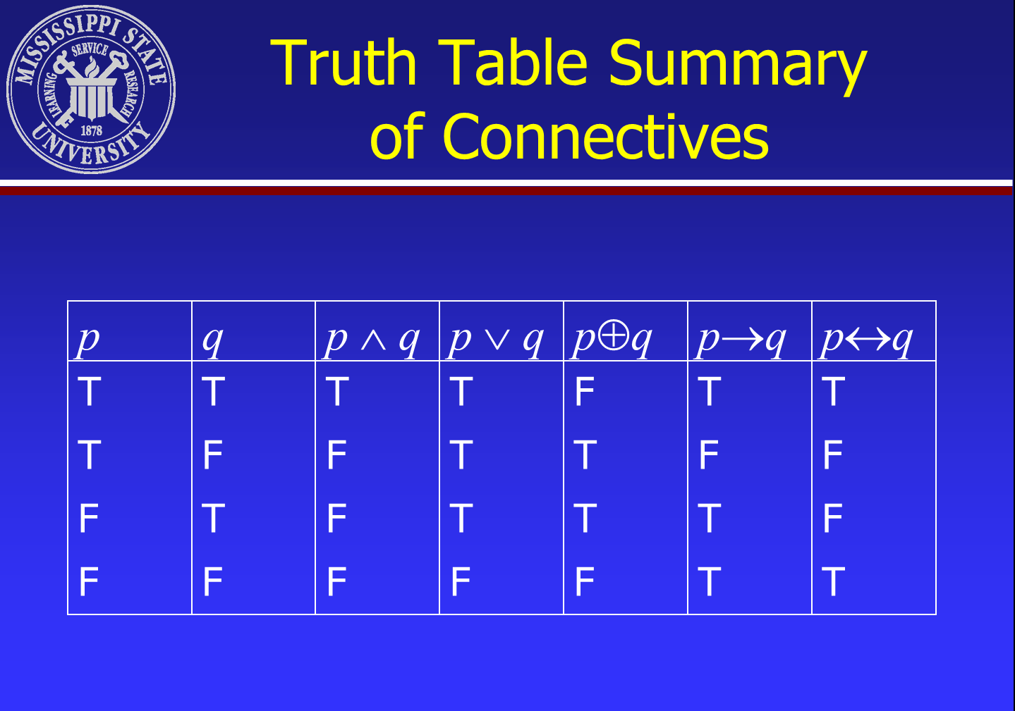

Slide 2
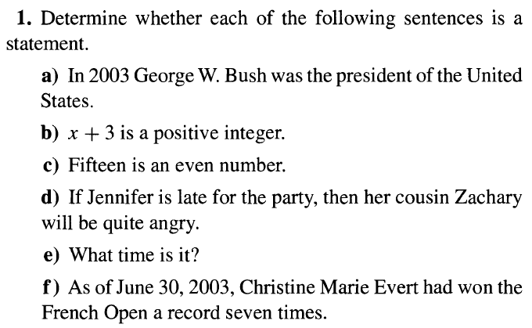
Mathematical Logic

Slide 3
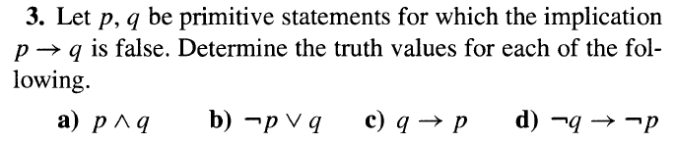
Mathematical Logic

Slide 4
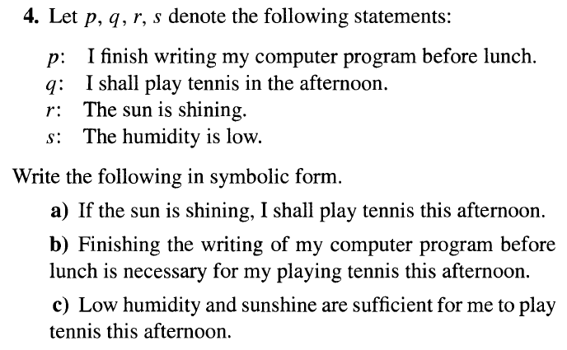
Mathematical Logic

Slide 5
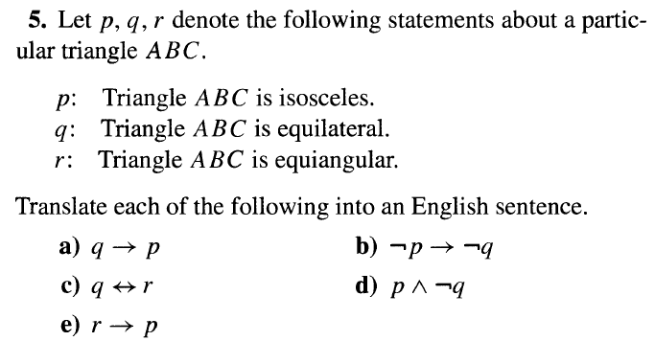
Mathematical Logic

Slide 6
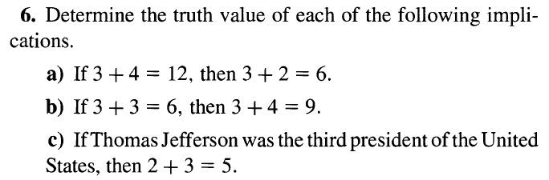
Mathematical Logic

Slide 7
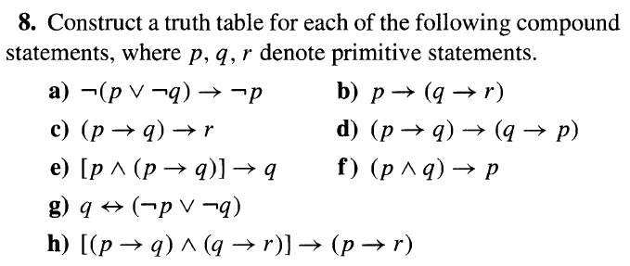
Mathematical Logic

Slide 8
Mathematical Logic
Basic connectives and truth tables
Def. 2.1. A compound statement is called a tautology(T₀) if it is true for all truth value assignments for its component statements.
If a compound statement is false for all such assignments, then it is called a contradiction(F₀).
: tautology
: contradiction

Slide 9
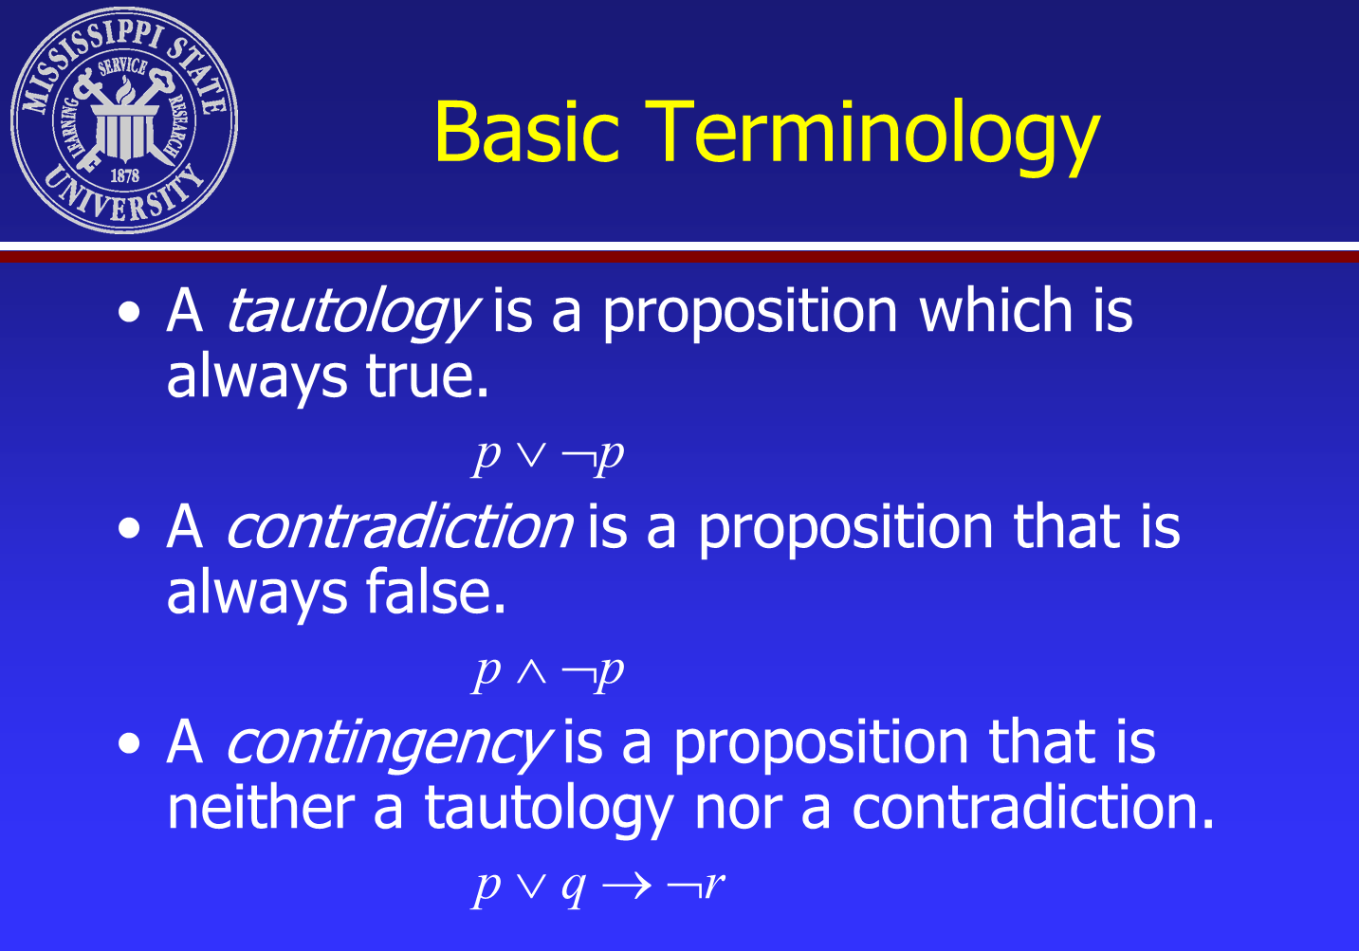

Slide 10
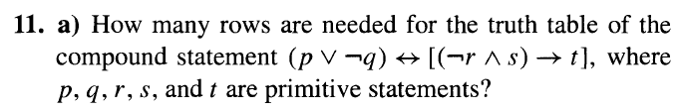
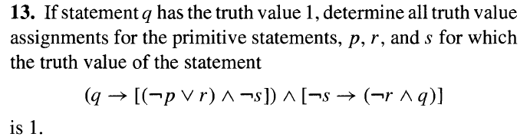
Mathematical Logic

Slide 11
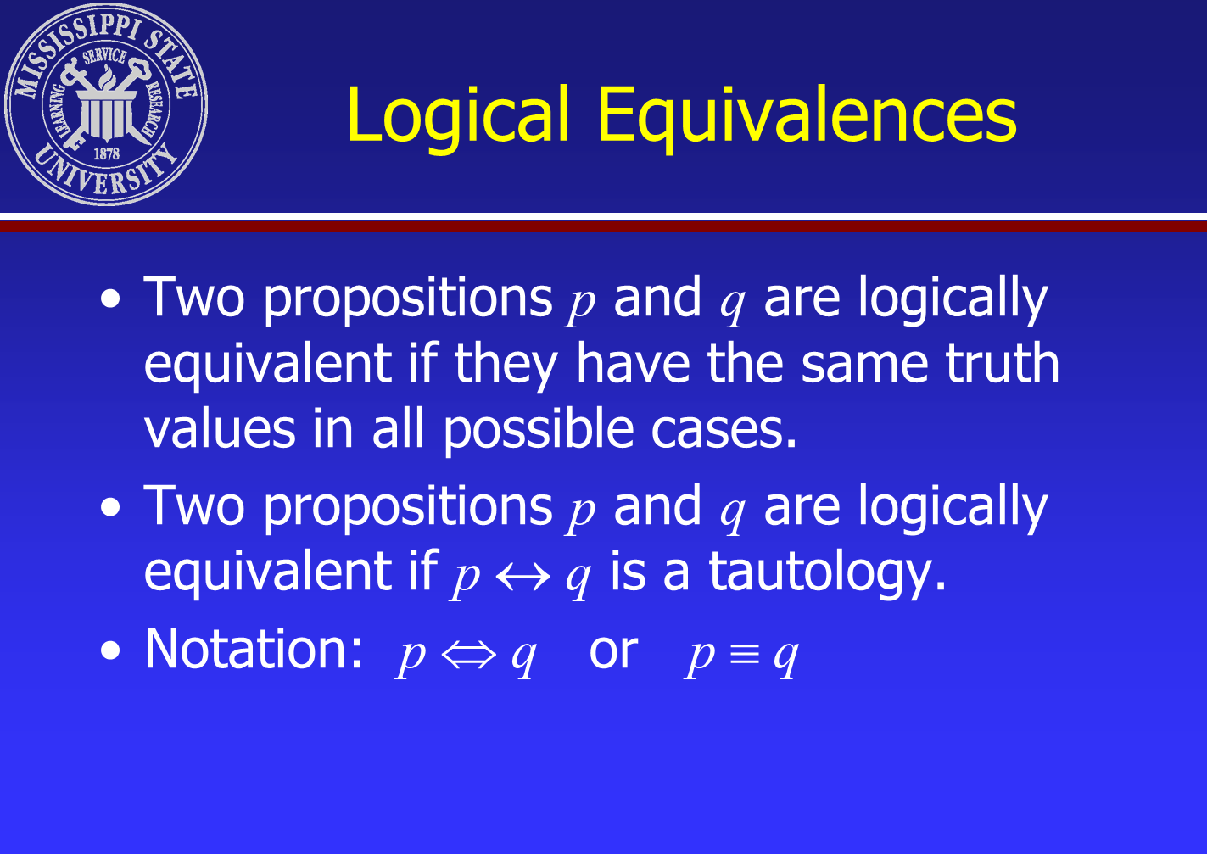
Mathematical Logic

Slide 12

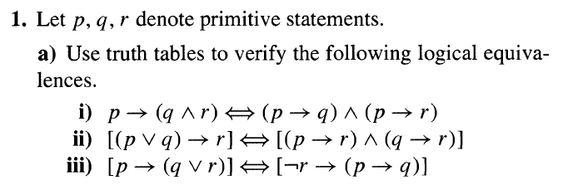
Mathematical Logic
Show that ¬(p ∨ q) and ¬p ∧ ¬q are logically equivalent.
Show that ¬(p ∨ (¬p ∧ q)) and ¬p ∧ ¬q are logically equivalent.

Slide 13
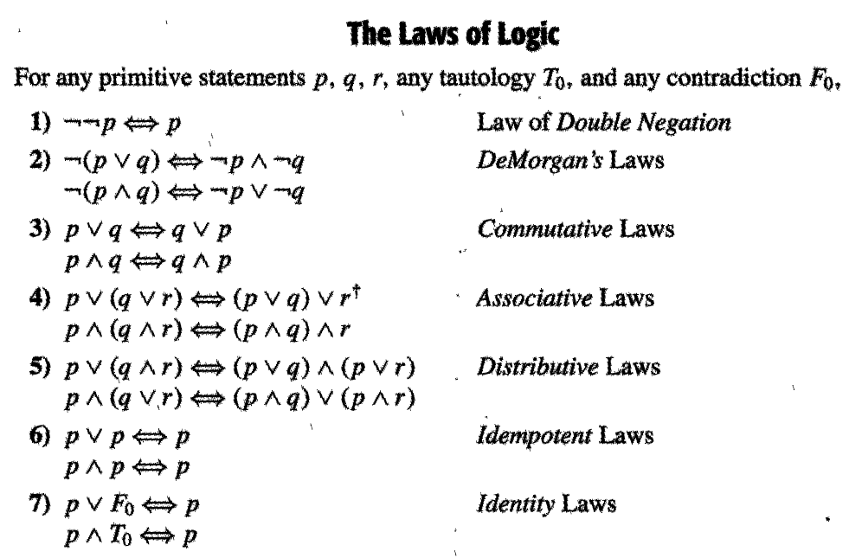
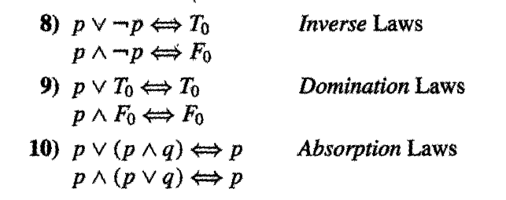
Mathematical Logic

Slide 14
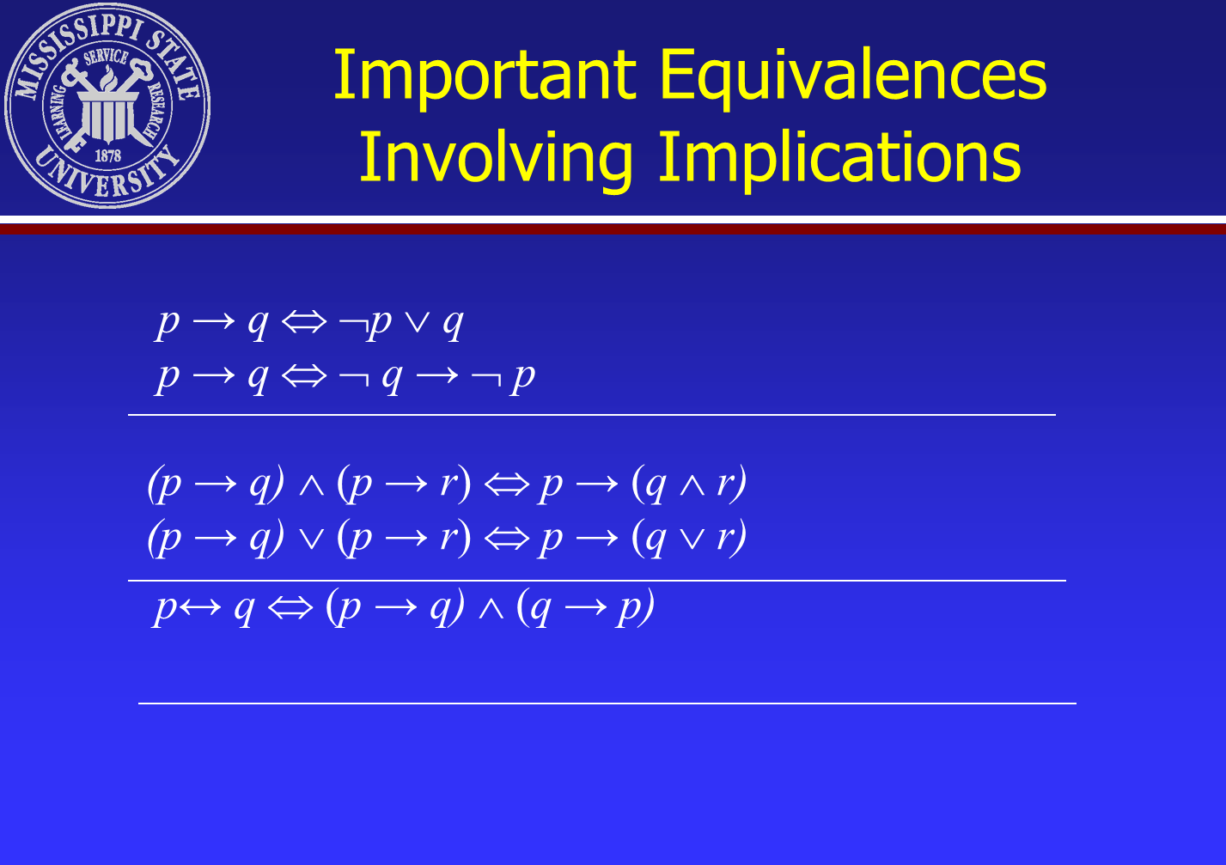
Mathematical Logic

Slide 15




Mathematical Logic

Slide 16
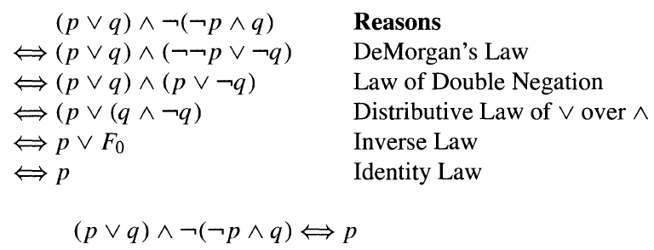
Mathematical Logic

Slide 17
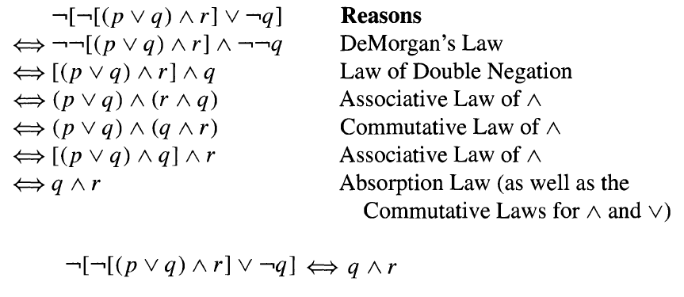
Mathematical Logic

Slide 18
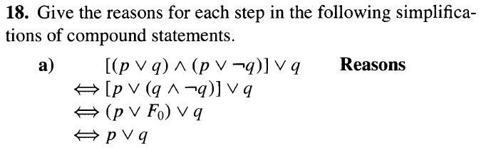
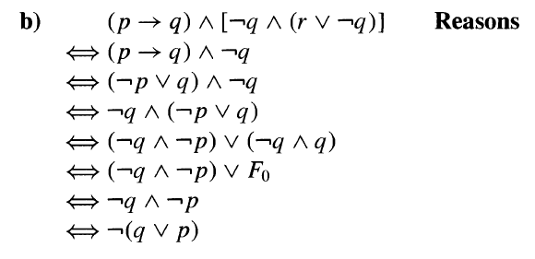
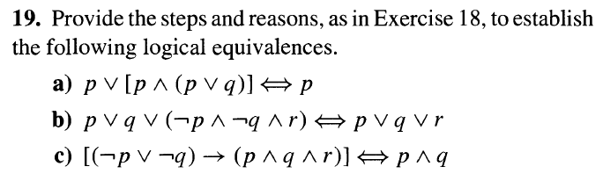
Mathematical Logic

Slide 19
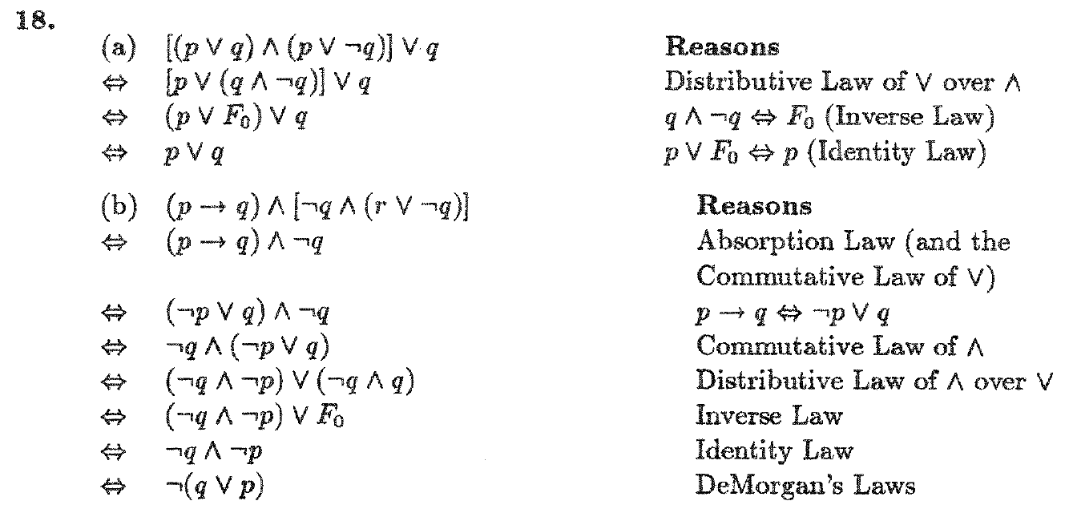
Mathematical Logic

Slide 20
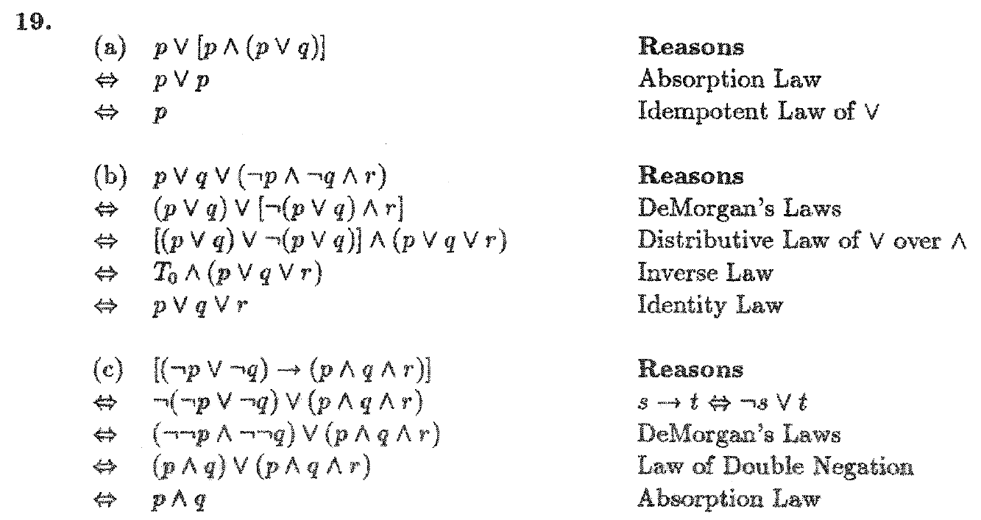
Mathematical Logic

Slide 21
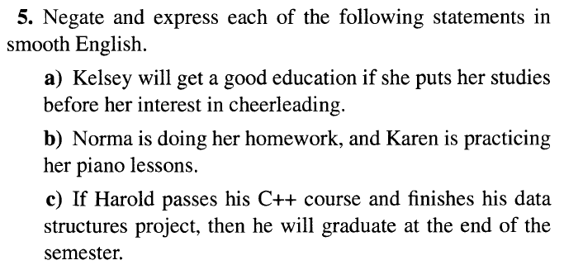
Mathematical Logic

Slide 22
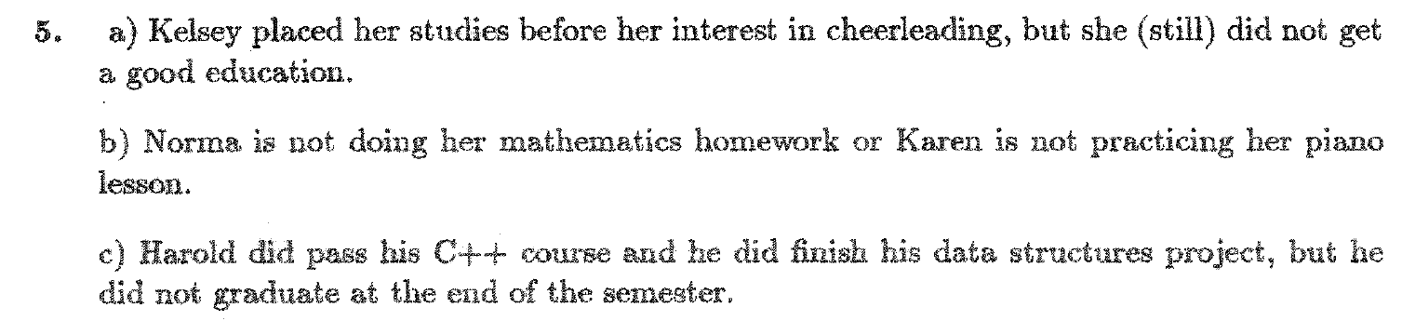
Mathematical Logic

Slide 23
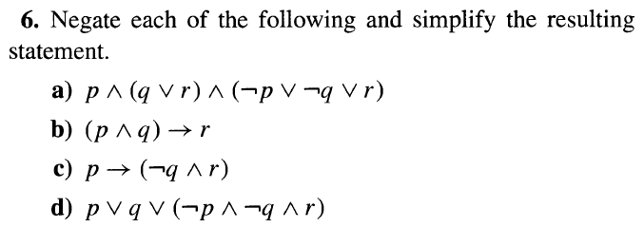
Mathematical Logic

Slide 24
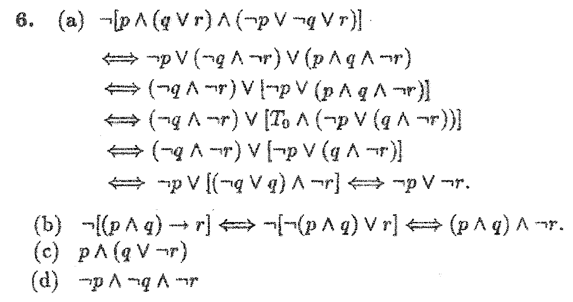
Mathematical Logic

Slide 25
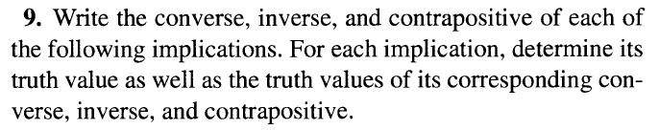

Mathematical Logic

Slide 26
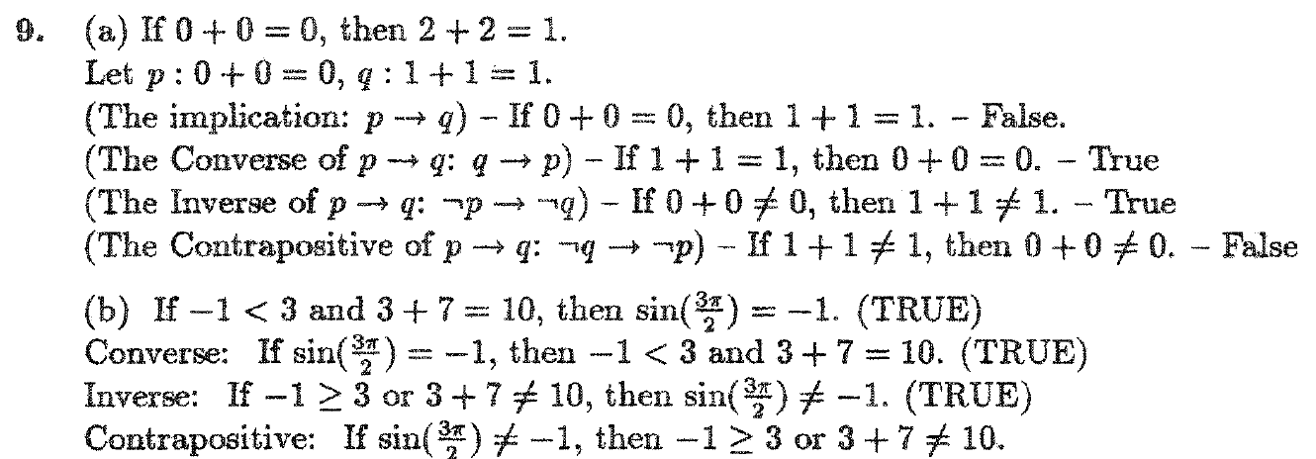
Mathematical Logic

Slide 27
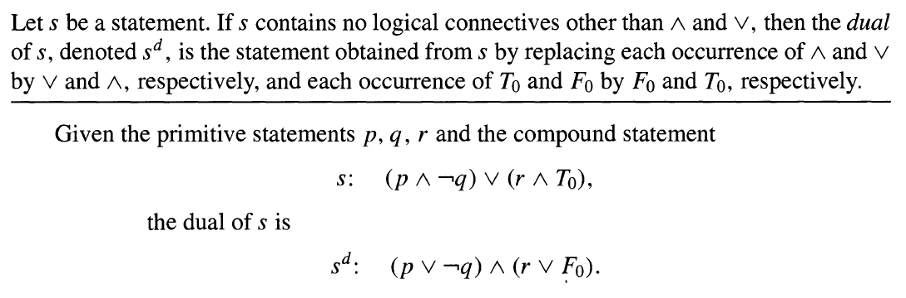

Mathematical Logic

Slide 28
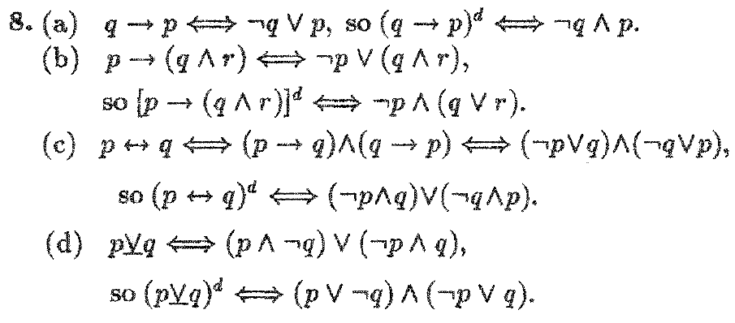
Mathematical Logic

